Slide 1
Overview
What is an API?
How APIs Work on the Internet
Usage of APIs
Types of APIs (Including REST APIs)
Building a REST API

Slide 2
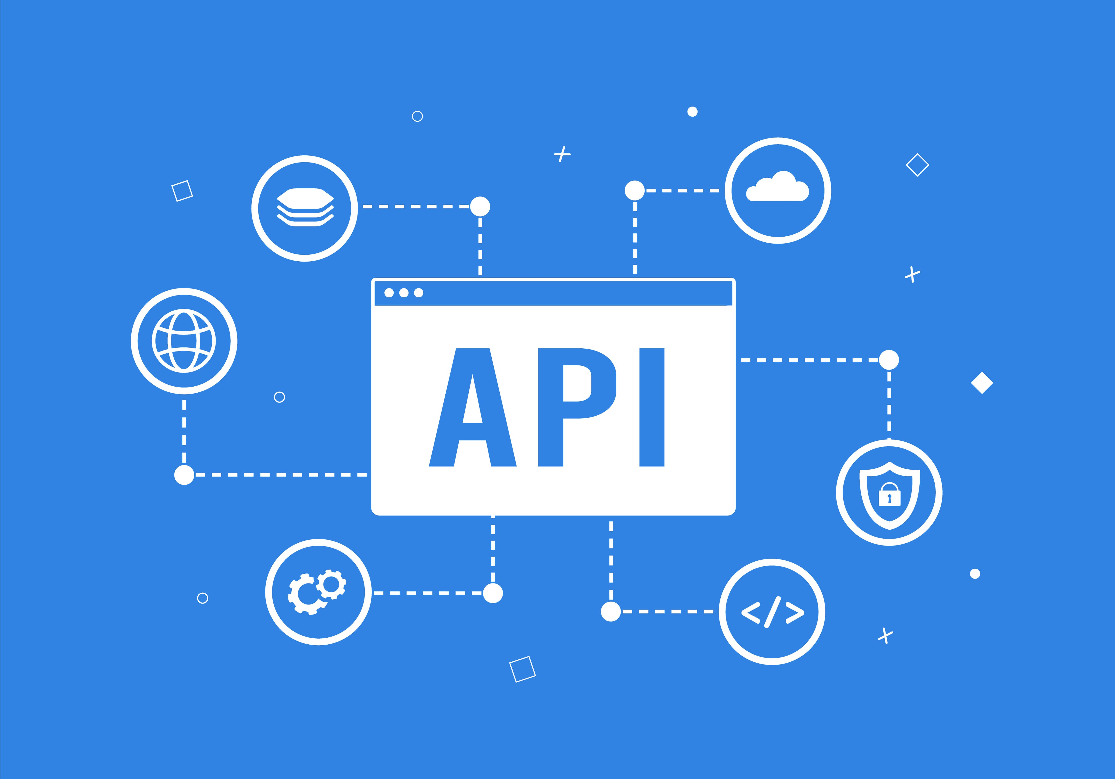
What is an API?
An API (Application Programming Interface) is a set of rules that allows different software entities to communicate. It simplifies complex operations by exposing specific functionalities, enabling integration without needing internal details. For instance, when you order food at a restaurant, you only interact with the menu, not the kitchen processes. Similarly, APIs provide a simplified interface for developers, abstracting the underlying complexity.

Slide 3
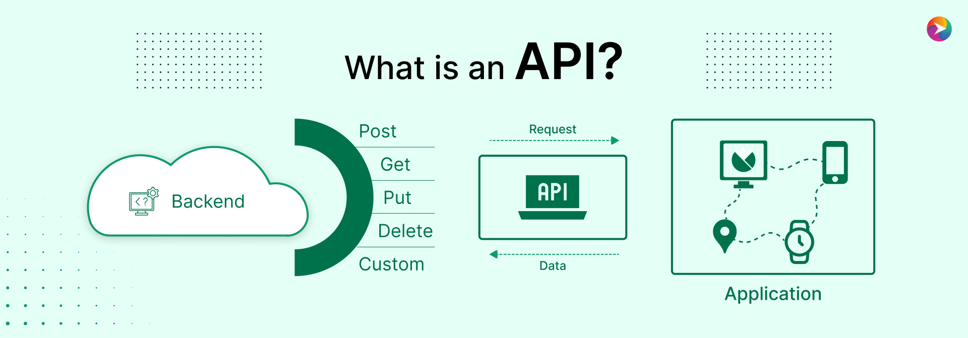
How APIs Work on the Internet
APIs facilitate communication between a client and a server. The client sends an HTTP request to the server, which processes it and sends back a response, usually in formats like JSON or XML. HTTP methods like GET, POST, and PUT dictate the nature of the interaction, and status codes such as 200 (OK) and 404 (Not Found) indicate the success or failure of the request.

Slide 4
Usage of APIs
APIs are integral to web and mobile development, enabling seamless data exchange between front-end and back-end. They are also crucial in cloud services for resource management and in IoT devices for communication. Moreover, APIs facilitate third-party integrations, enhancing functionalities such as payment processing, social media sharing, and location mapping, making them indispensable in modern software ecosystems.

Slide 5
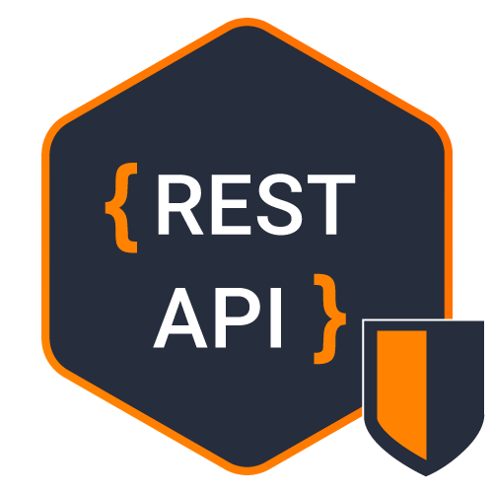

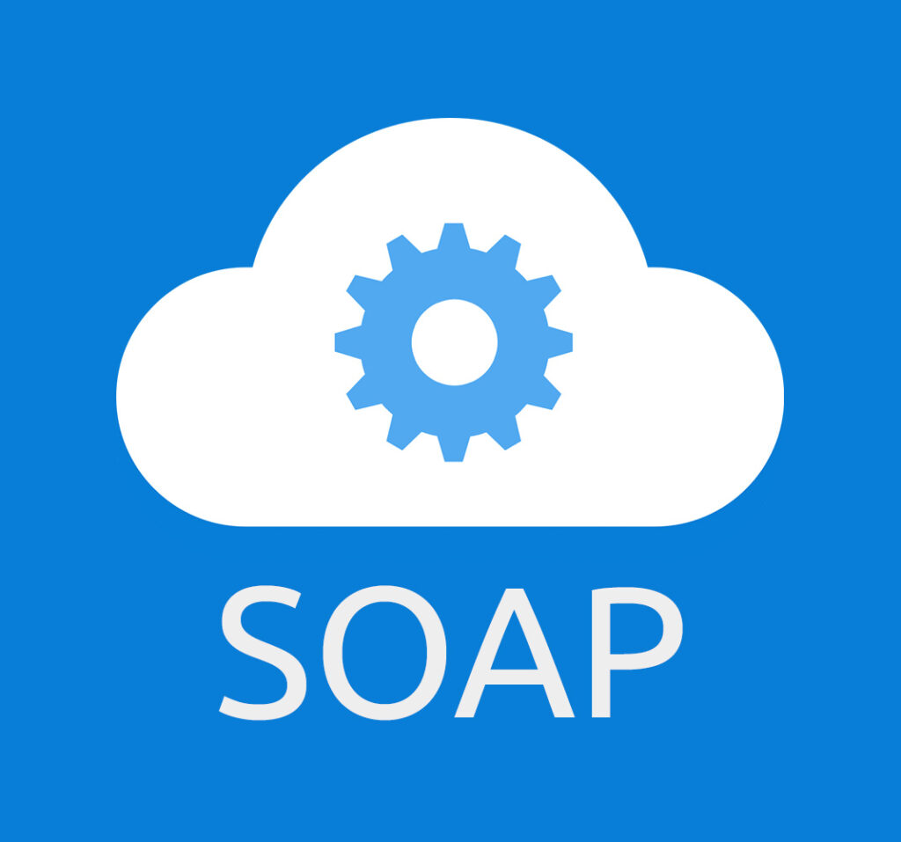
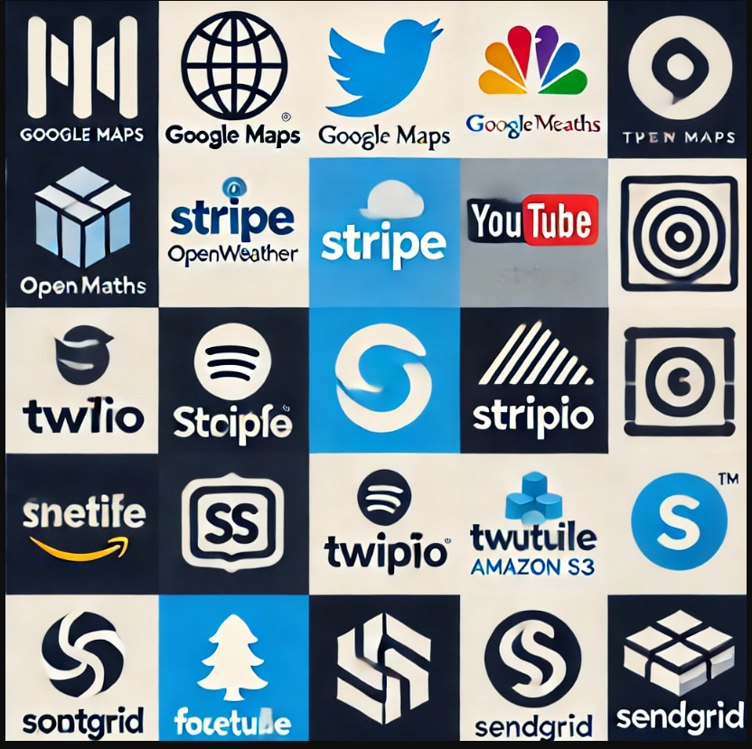
Types of APIs
APIs come in various types, including REST, SOAP, and GraphQL. REST APIs are popular for their simplicity and efficiency, using standard HTTP methods. SOAP APIs are protocol-based and often used in enterprise environments. GraphQL offers flexibility in data querying. Additionally, third-party APIs, like those from social media or payment platforms, allow easy integration of external services into applications.
Rest API GraphQL SOAP API Third party API’s

Slide 6
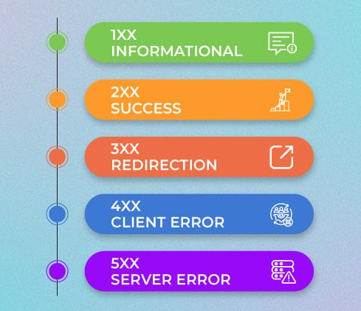
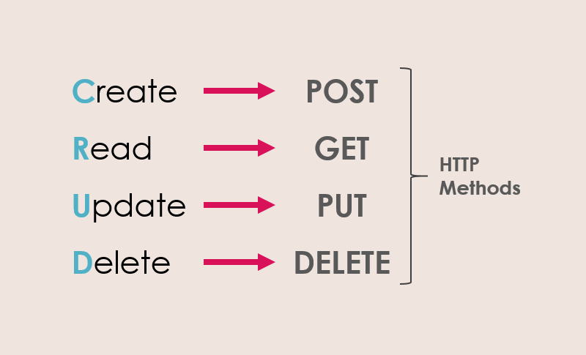
REST API Basics
REST (Representational State Transfer) APIs adhere to principles like statelessness and client-server separation. They use HTTP methods (GET, POST, PUT, DELETE) to perform CRUD operations. REST APIs are easy to use, scalable, and support multiple data formats. Common HTTP status codes include 200 (OK), 404 (Not Found), and 500 (Internal Server Error), which provide feedback on request outcomes.
HTTP Status Codes HTTP Methods

Slide 7
REST API in Action
To demonstrate a REST API, we can use Spring for back-end development and Postman for testing endpoints. Screenshots of CRUD operations in Spring, like creating or updating records, along with Postman requests and responses, provide a clear view of how the API functions. This practical approach helps visualize the interaction between client requests and server responses.

Slide 8
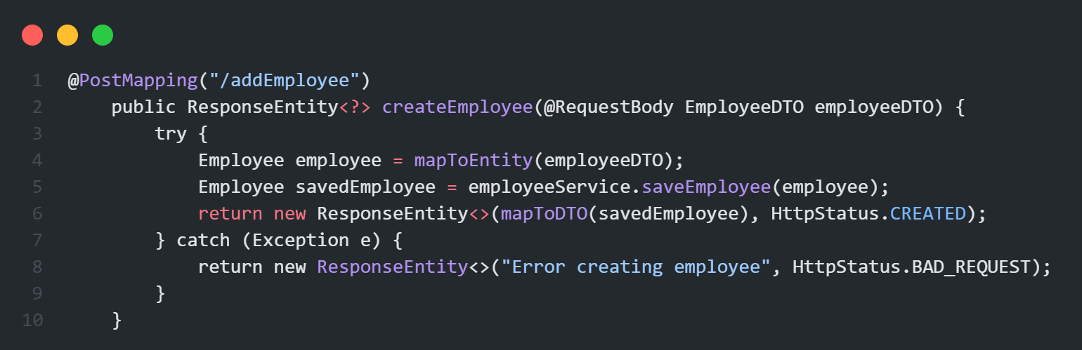
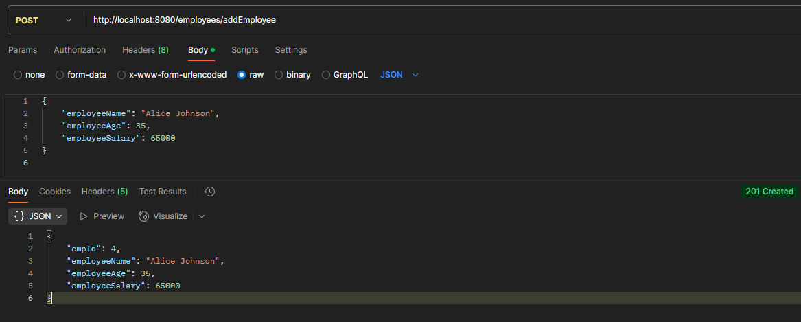
POST Method ( create )

Slide 9
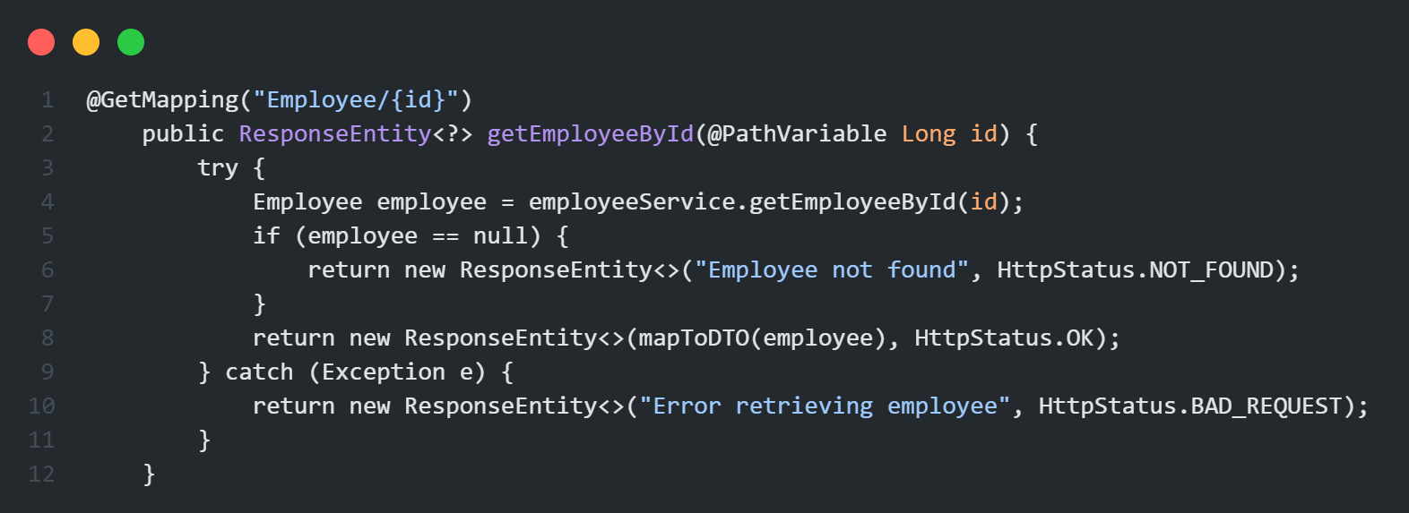
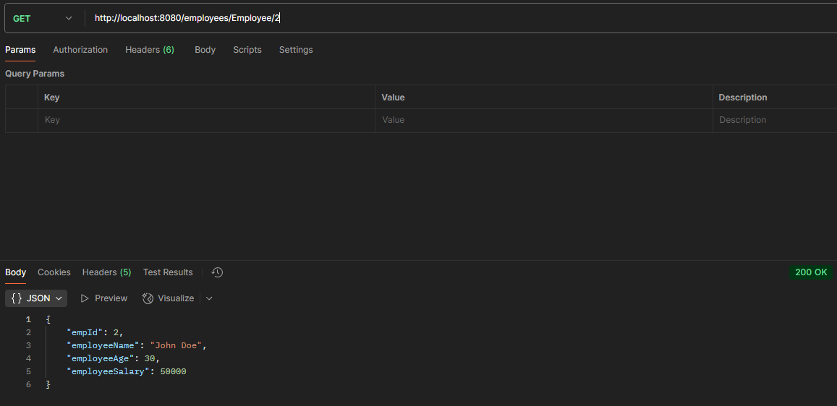
GET Method ( fetch )

Slide 10
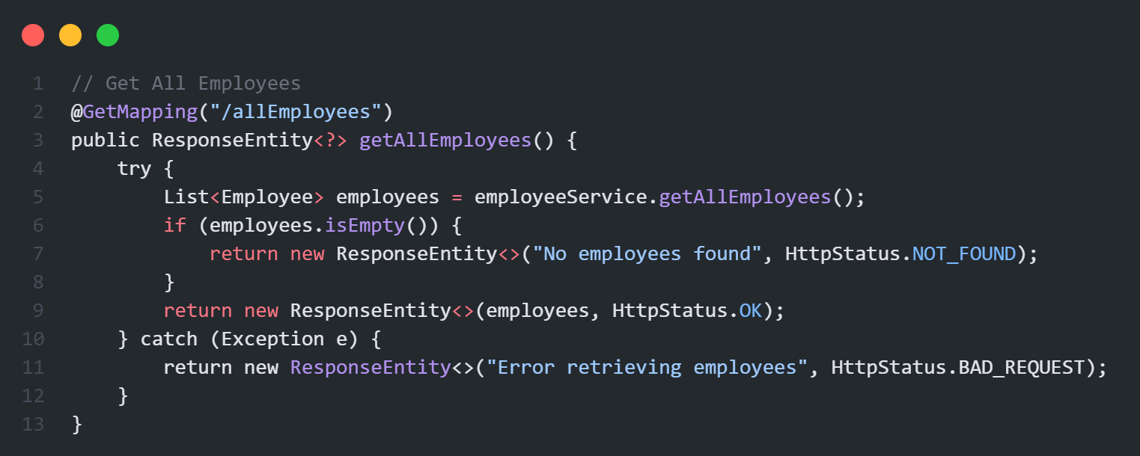
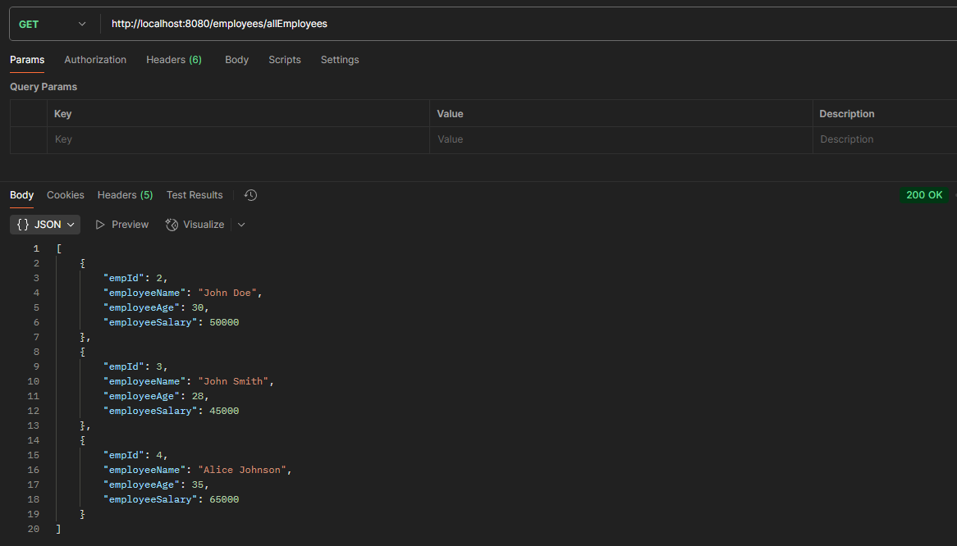
GET Method ( fetch all)

Slide 11
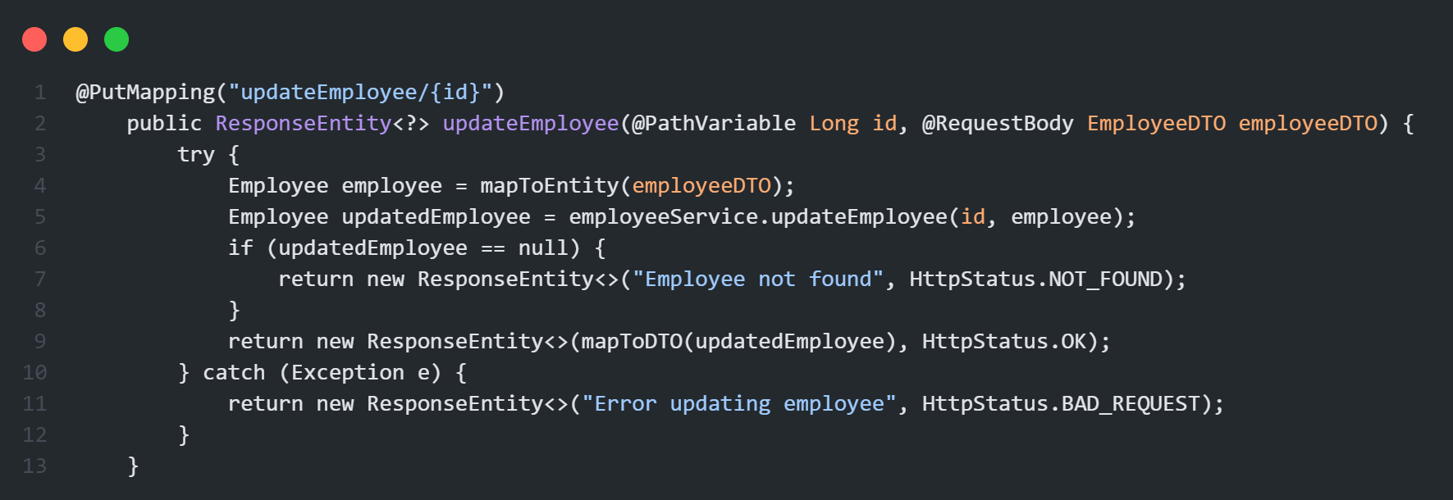
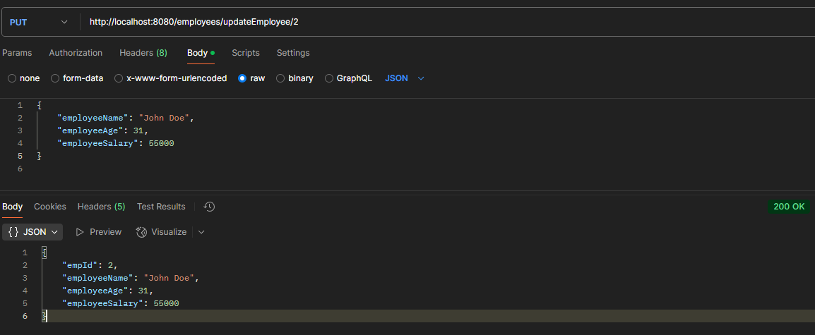
PUT Method ( update )

Slide 12
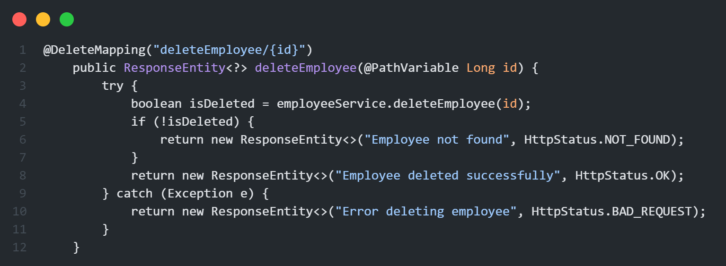
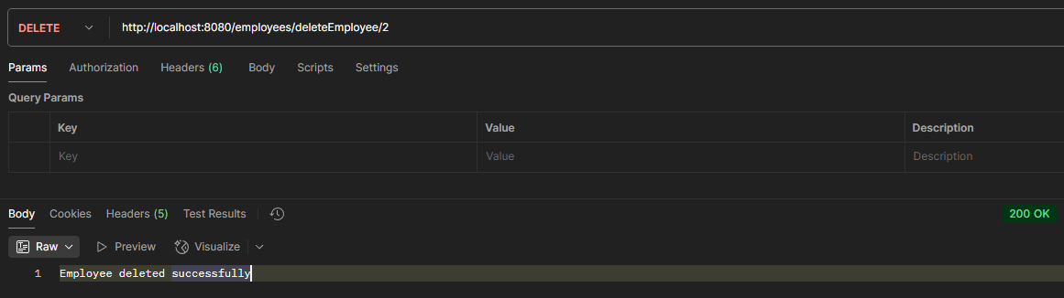
DELETE Method ( delete )

Slide 13
Conclusion
APIs are vital for modern software development, enabling seamless integration and scalability. REST APIs, with their simplicity and adherence to HTTP standards, have become a preferred choice for many developers. They allow for modular design and efficient resource handling, paving the way for robust, interconnected systems that drive today's digital experiences.

Slide 14
THANK YOU ALL !!!

